Slide 1
King County Housing Analysis
How to maximize value by Mercy Ngila

Slide 2
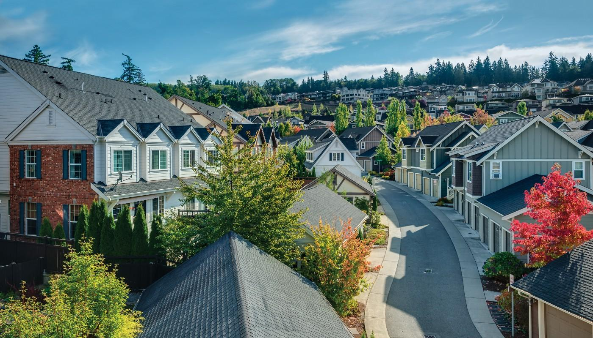

Slide 3
The problem
Company
Problem statement
Problem statement
Sunset Real Estate Company
The Company, is currently exploring the idea of purchasing properties to remodel either for the purpose selling or renting to prospective clients in King County.

Slide 4
Objectives
Objective 1
Objective 2
Objective 3
To build a model that predicts the price of houses with an acceptably high accuracy.
To identify variables with the most weight when it comes to predicting the highest market price.
To advice on the best investment strategy

Slide 5
Best model for maximized market price
EDA
Multiple Regression
Conclusion
Business Problem
Data
Methods
Recommendations
Conclusion
Kc Housing Data, previous King County Housing data
Best Investment Strategy

Slide 6
Key Factors
Key factors driving high market price

Slide 7
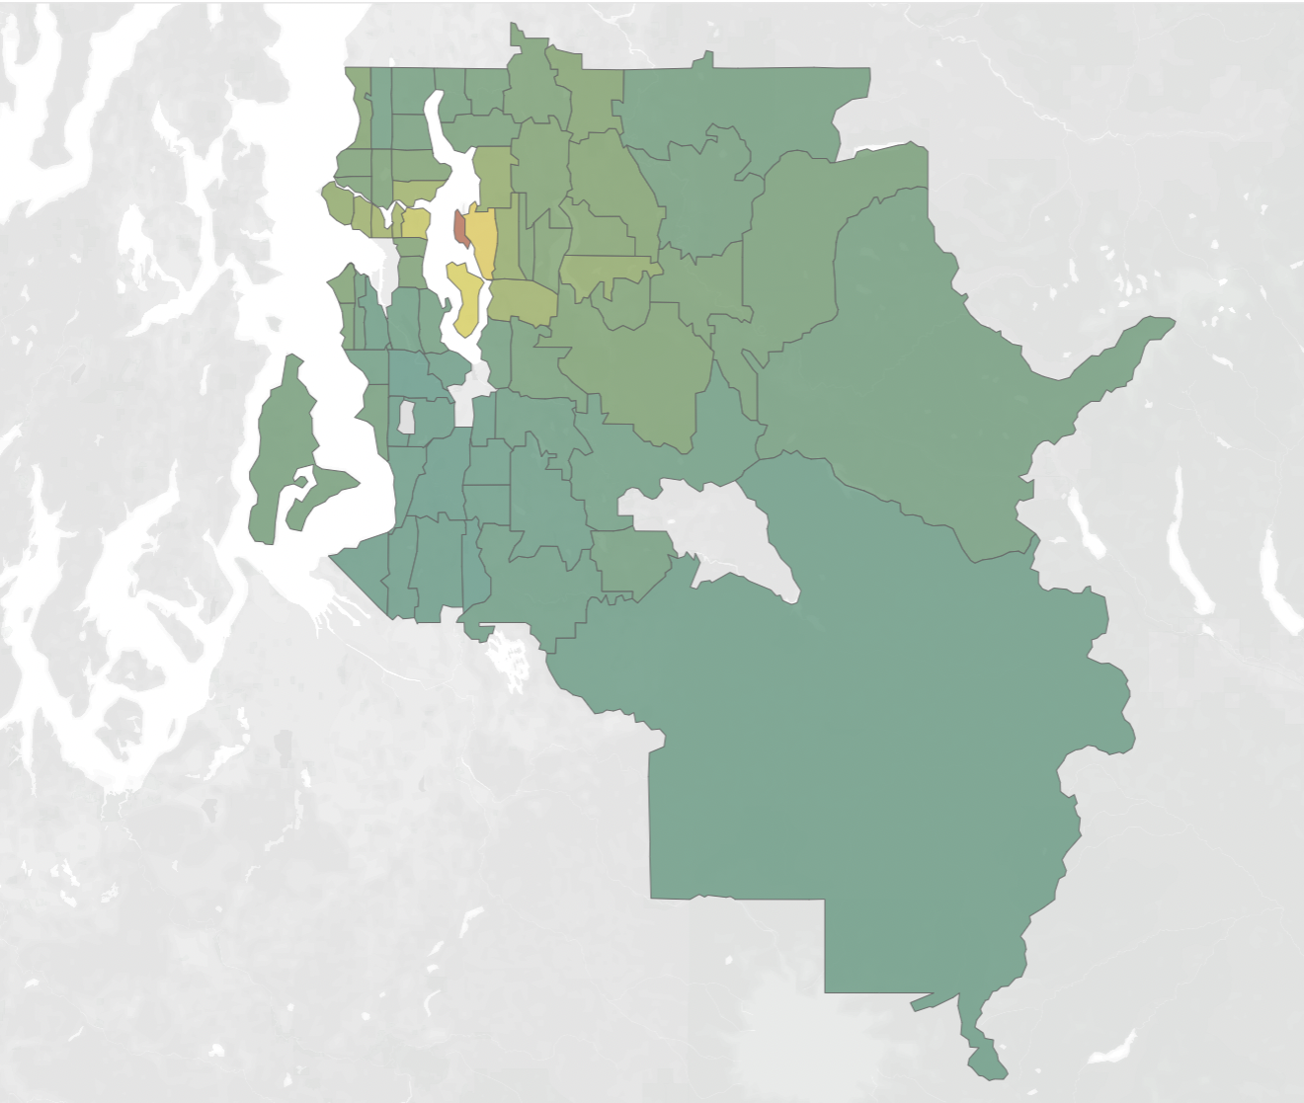
Location
A volatile factor in home value
Some zip codes will fetch more $$$ than others

Slide 8
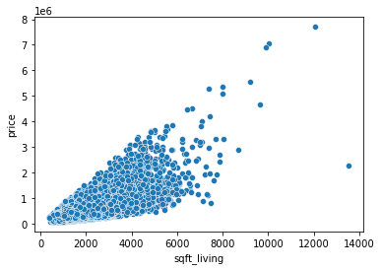
Spacious Interiors
More square footage in the house
More space = More $$$

Slide 9
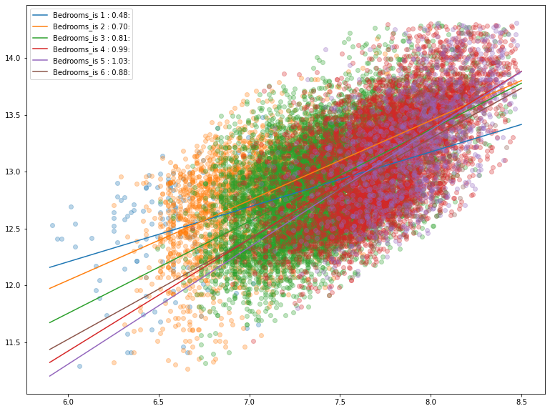
Bedrooms
Less is more with bedrooms
An average of 2 or 3 bedrooms would be ideal.

Slide 10
Recommendations

Slide 11
To generate higher sale prices, Sunset Real Estate should focus on houses with few bedrooms (1,2 &3).
Recommendation 1
Sunset should also consider a further analysis on the demographic and purchasing power of the people of King County to understand their buying potential.
Recommendation 2
A ideal house that would fetch the highest price in the market would be approximately 3 bedrooms, in Medina, WA (Zipcode 98039) with view 2 and in condition 5 and a high sqft living.
Recommendation 3

Slide 12
A major opportunity would be to find home which falls into the lower conditions category and possibly renovate them in order to change the condition to the middle to higher categories in order to to increase the estimated sales price.
Recommendation 4
Recommendation 5
Another consideration would be the distance to the top companies in the county to determine if it could be the cause for people settling in specific zip codes.

Slide 13
The End

